Slide 1
Off-resonance
Pablo Irarrazaval

Slide 2
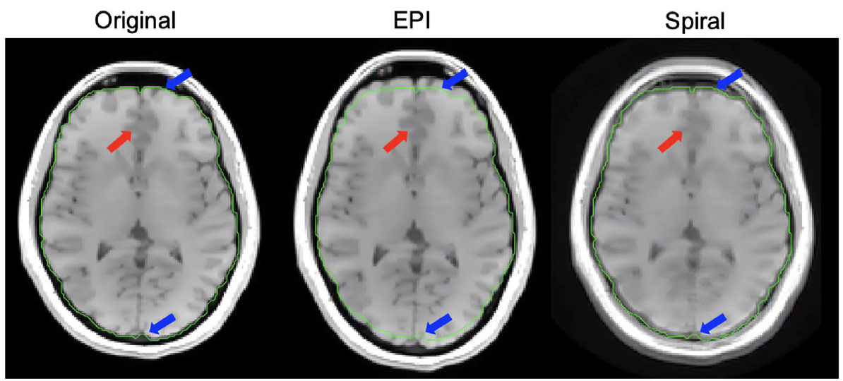
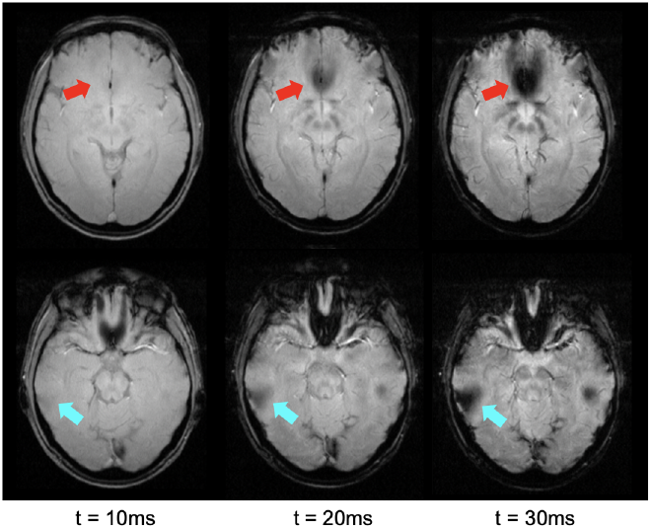
Off-resonance distortions
Haskell et al, NMR in Biomedicine 2022

Slide 3
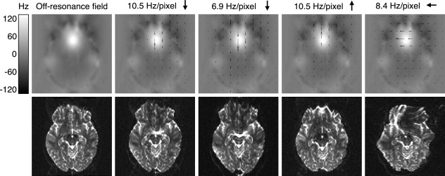
Off-resonance distortions
Andersson, in Magnetic Resonance Technology and Applications, 2021

Slide 4
Topics
Off-resonance and its sources
Off-resonance effects
Off-resonance correction algorithms

Slide 5
Off-resonance and its sources

Slide 6
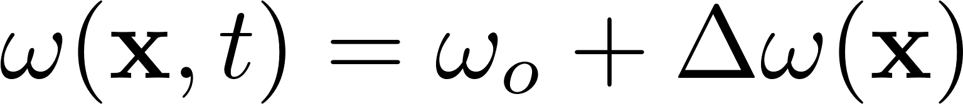
Off-resonance: what is it?
Expected field
Reality
Resonant frequency
Off-resonance

Slide 7
Sources of off-resonance
Main field inhomogeneity
Magnetic susceptibility
Chemical shift

Slide 8
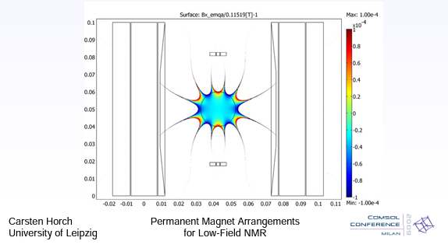
Off-resonance: what produces it?
Main field inhomogneity
Magnetic susceptibility
Chemical shift
Construction – Site – Shimming
Low cost

Slide 9
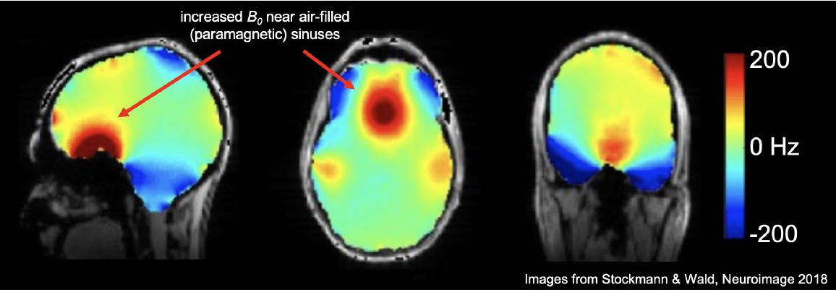
Off-resonance: what produces it?
Main field inhomogneity
Magnetic susceptibility
Chemical shift

Slide 10
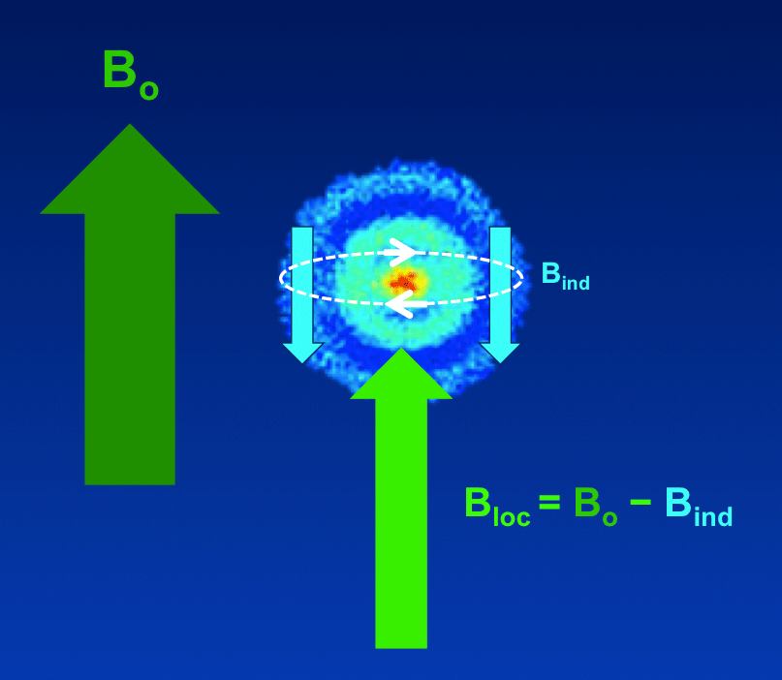
Off-resonance: what produces it?
Main field inhomogneity
Magnetic susceptibility
Chemical shift
https://mriquestions.com/

Slide 11
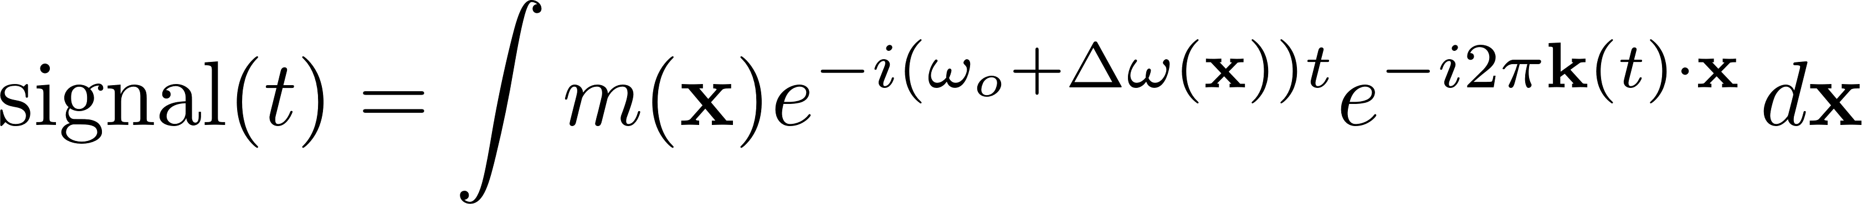

Signal equation and field strength
For example, fat has a 3.5 ppm shift
At 1.5T this is 224 Hz
At 3.0T this is 448 Hz

Slide 12
Off-resonance effects

Slide 13
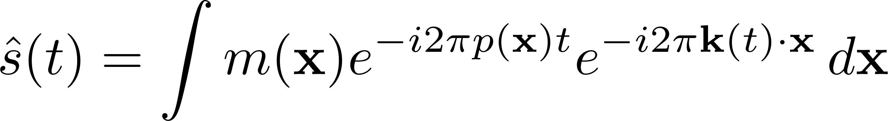
Signal equation and effects
Let the off-resonance be p(x) in Hz:
Effects:
Signal loss
Geometric distortions
Blurring

Slide 14
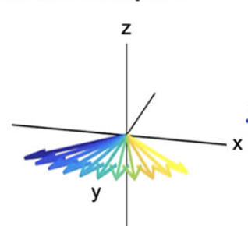
Off-resonance effect: signal loss
Let the off-resonance be p(x) in Hz:
dephasing within a voxel
Haskell et al, NMR in Biomedicine 2022

Slide 15
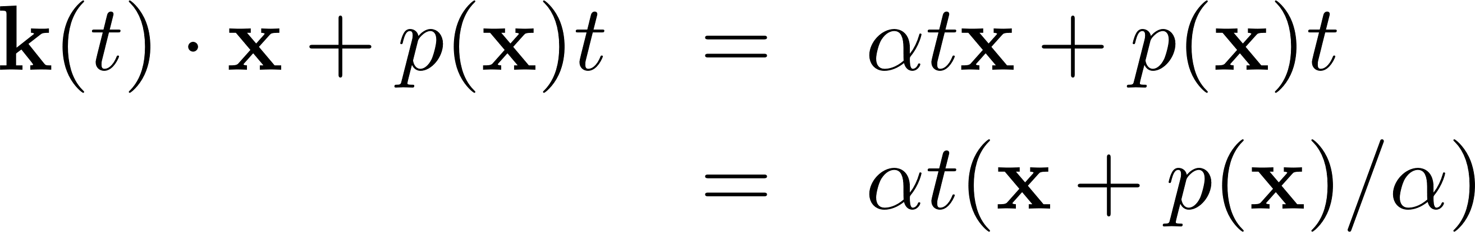
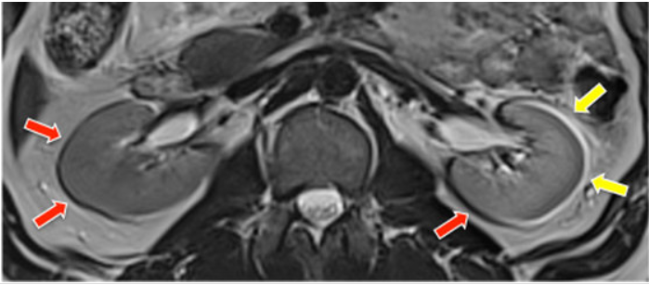
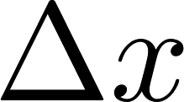
Off-resonance effect: Geometric distortion
Let the off-resonance be p(x) in Hz:
phase encoding no longer linear. If Cartesian encoding:
https://mriquestions.com/

Slide 16
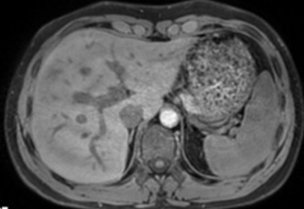
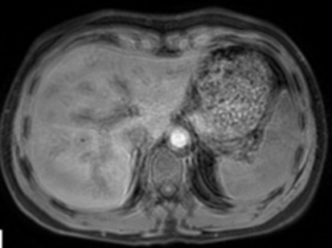
Off-resonance effect: Blurring
Let the off-resonance be p(x) in Hz:
phase encoding no longer linear.
If non-uniform encoding, k-space positions are no longer well-defined.
Börnert, JMRI 2010

Slide 17
Off-resonance correction

Slide 18
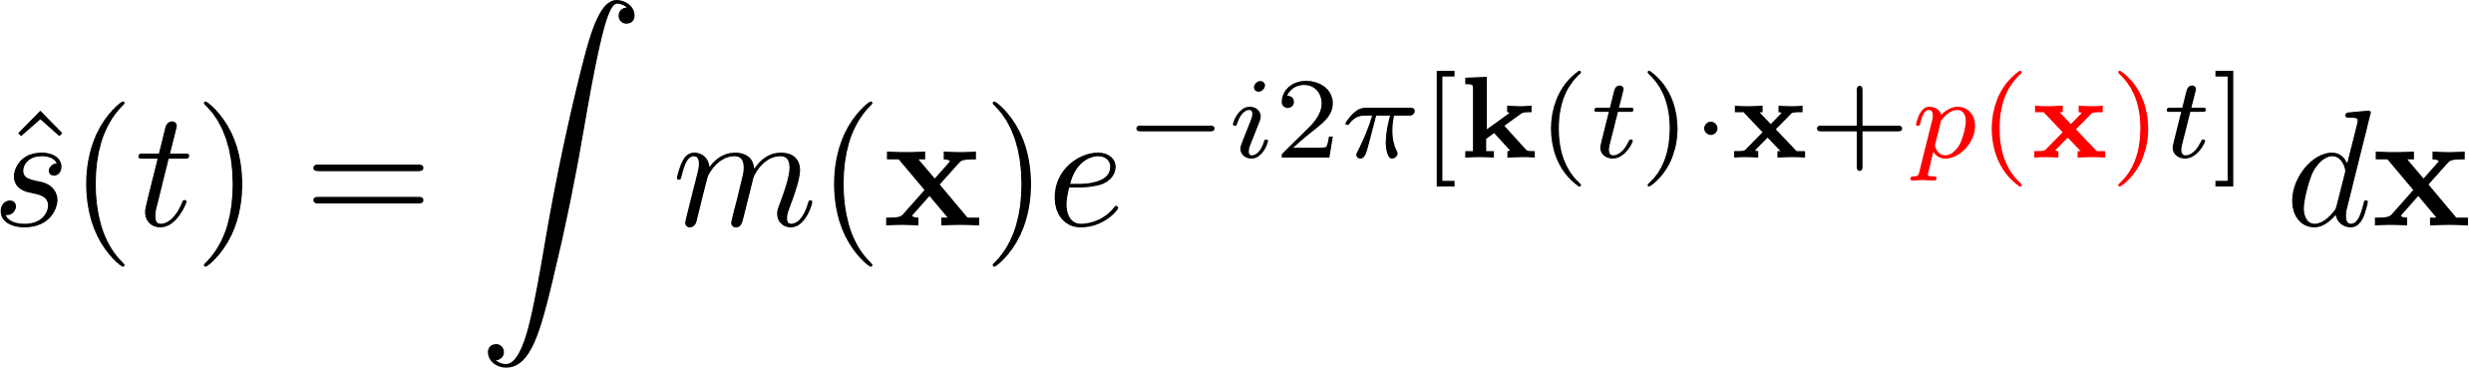
Field map approximations
Linear
Piecewise constant
Others

Slide 19
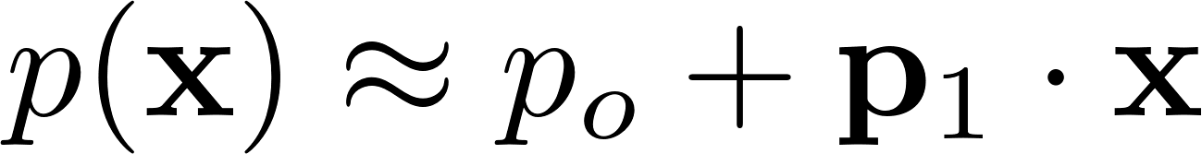
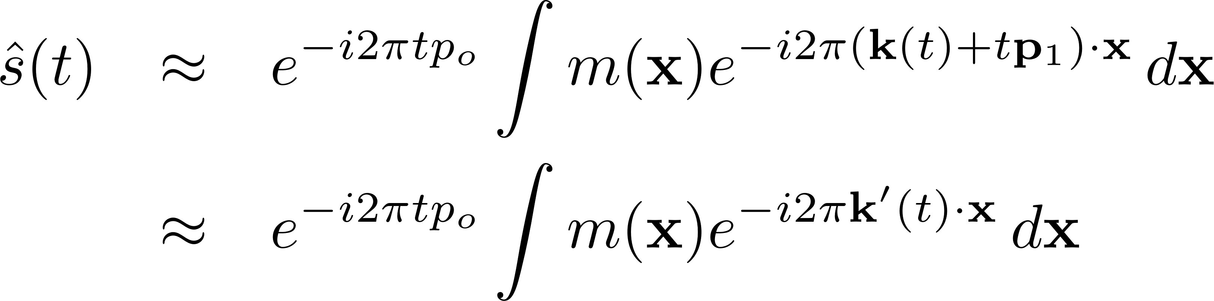
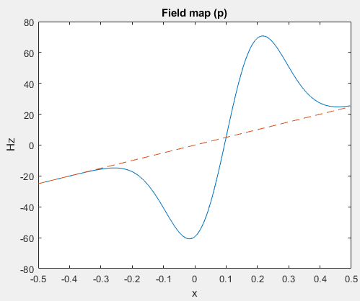
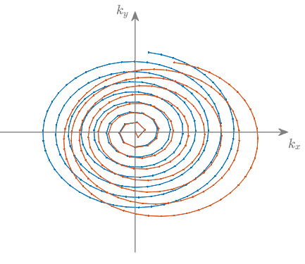
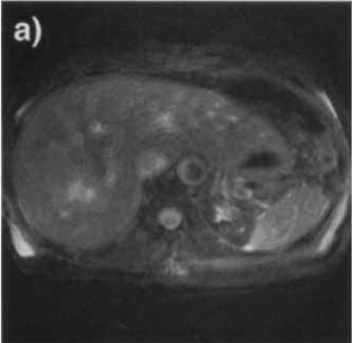
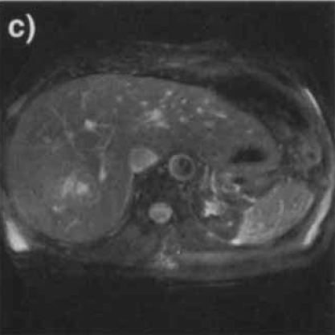
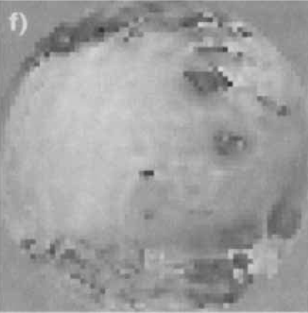
Field map approximations
Linear
Piecewise constant
Uncorrected
Corrected
Irarrazabal, MRM, 1996

Slide 20
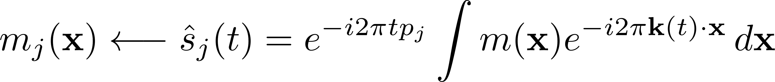
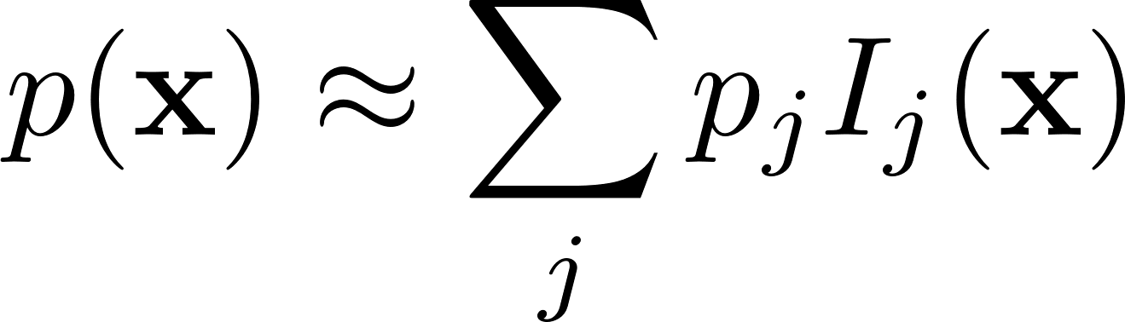
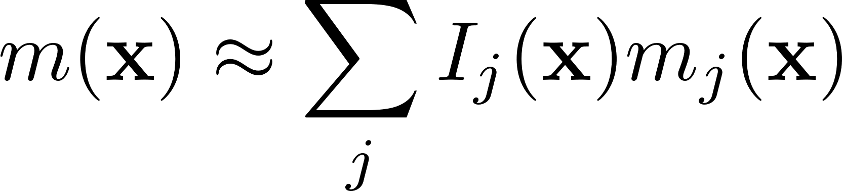
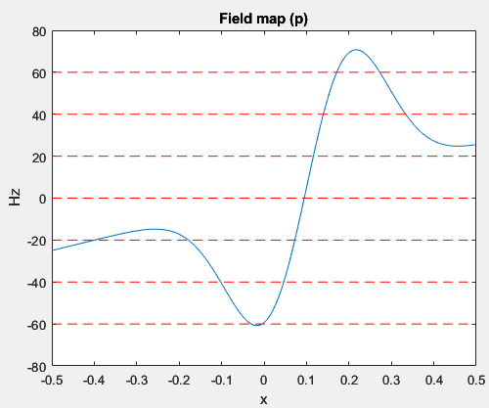
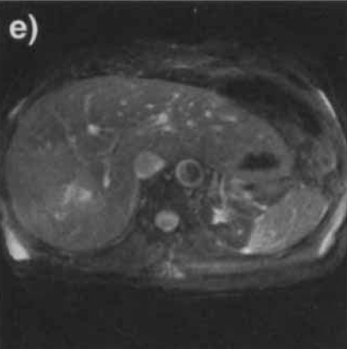
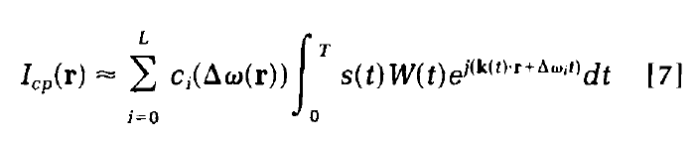
Field map approximations
Linear
Piecewise constant
(Frequency Segmented)
Uncorrected
Corrected
Multifrequency Interpolation (MFI)
Noll, IEEE TMI, 1991; Man, MRM, 1997

Slide 21
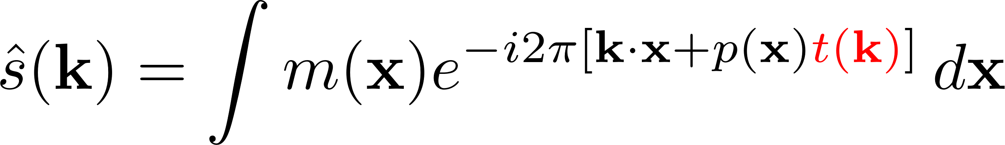
Time map approximations
Linear
Piecewise constant

Slide 22
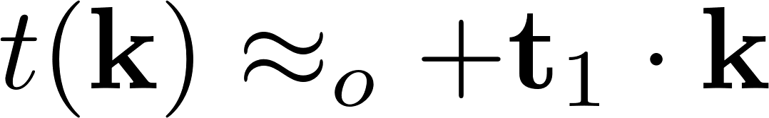
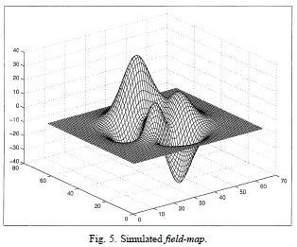
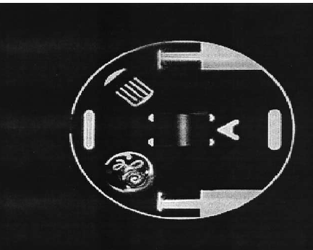
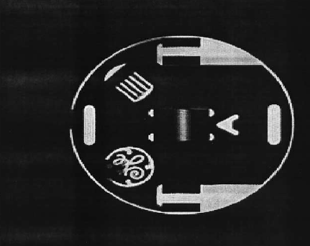
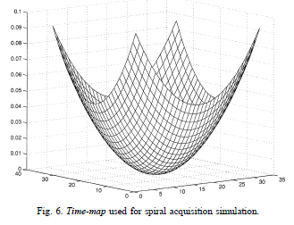
Time map approximations
Linear
Piecewise constant
Uncorrected
Corrected
Akel, MRI, 2002

Slide 23
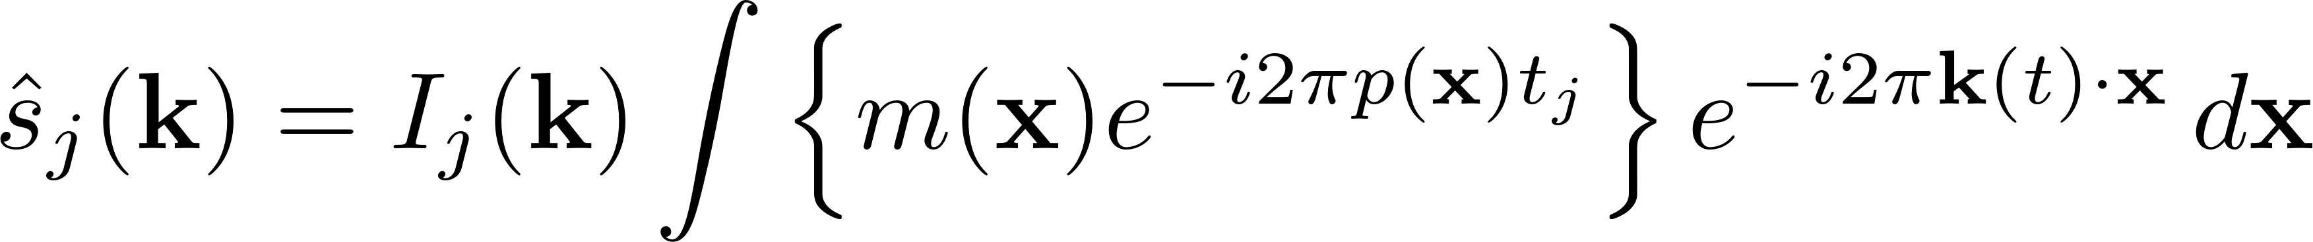
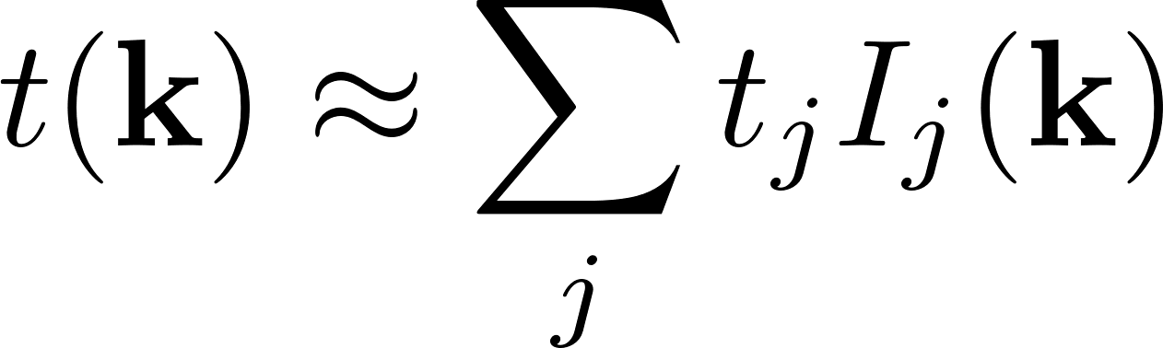
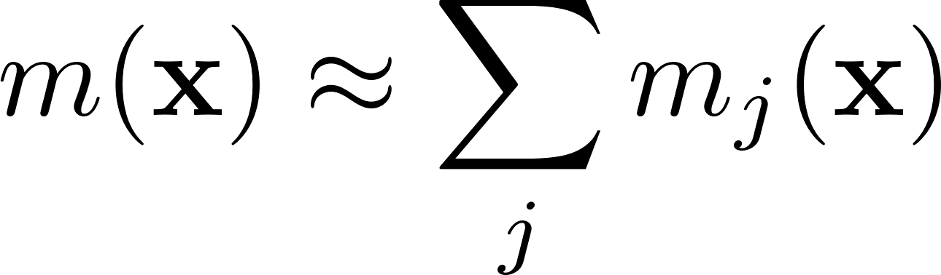
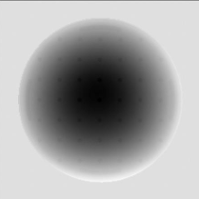
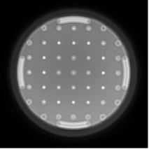
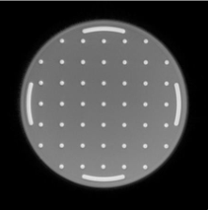
Time map approximations
Linear
Piecewise constant
(Time segmented)
Uncorrected
Corrected
Noll, IEEE TMI, 1991

Slide 24
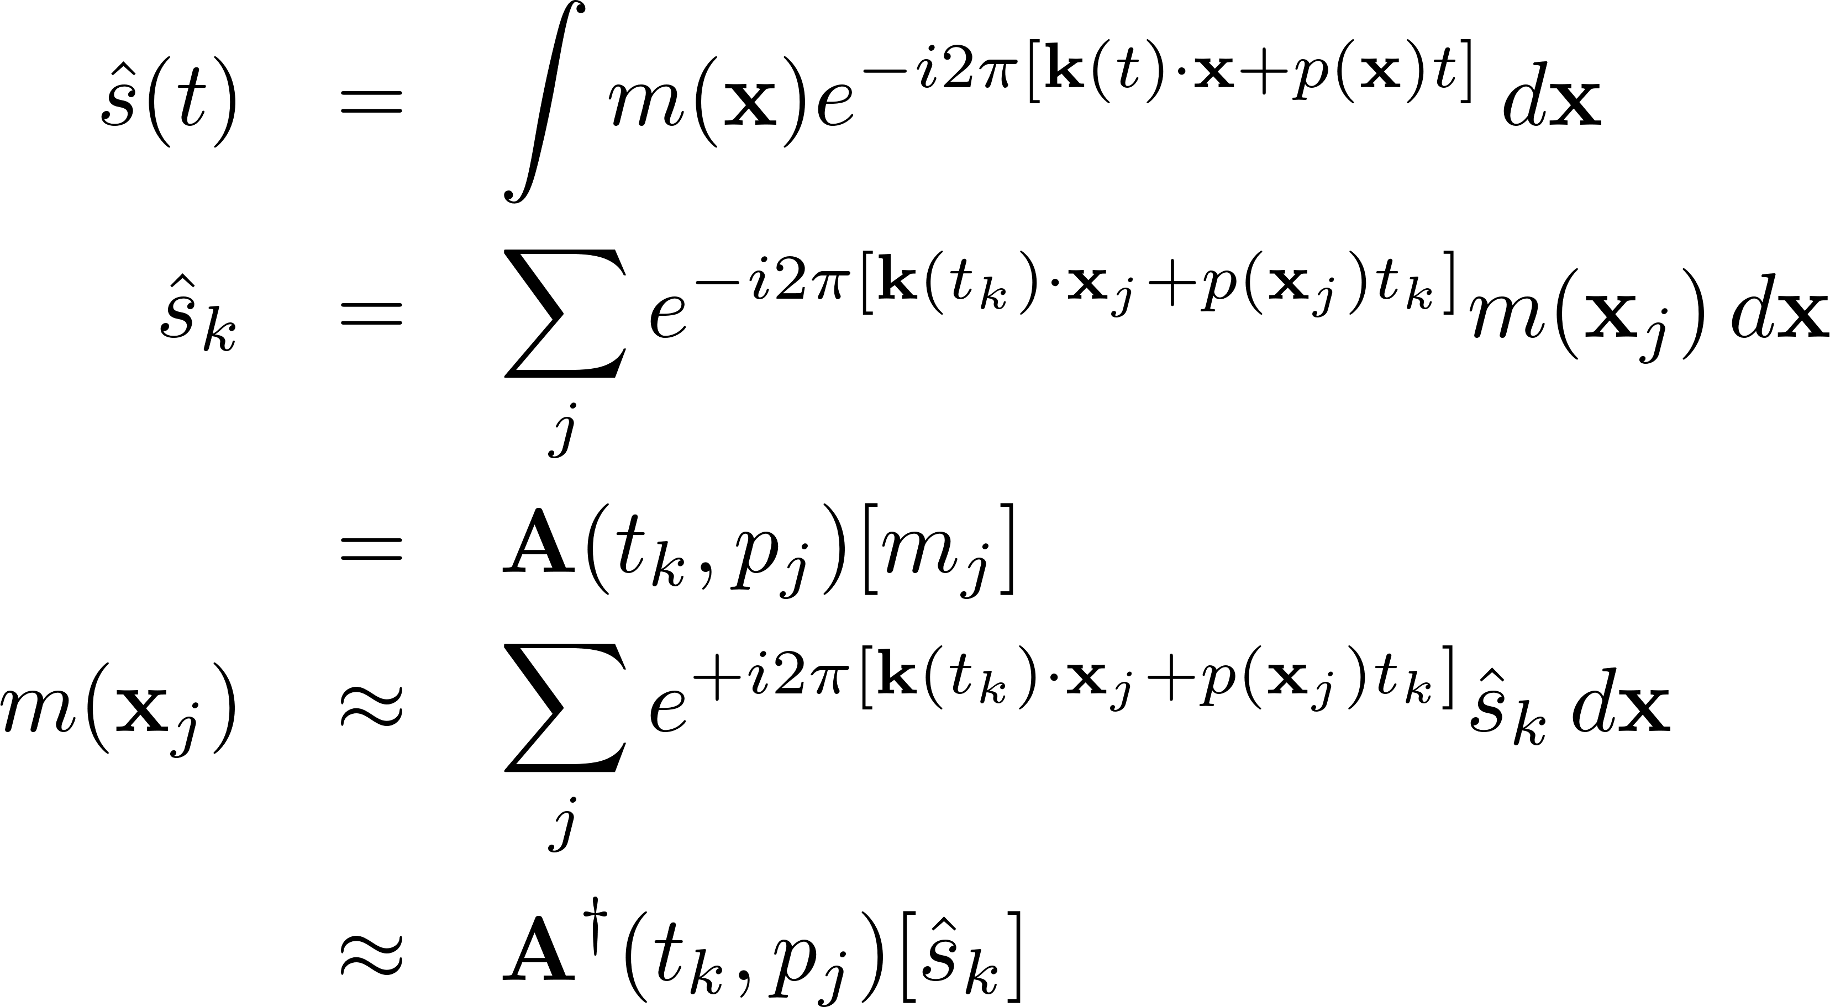
Conjugate Phase Reconstruction (CPR)
These are all approximations of the Conjugate Phase. They allow faster computation in comparison with multiplying by the conjugate matrix: O(N^2).

Slide 25
Off-resonance
Pablo Irarrazaval

